Slide 1
A.S.sai sruthi
3/21/2024 Annual Review

Slide 2
PROJECT TITLE
GENERAL CHATBOT IN DECISION TREE ALGORITHM
3/21/2024 Annual Review

Slide 3


AGENDA
1.Understanding User Input
2.Decision Tree Construction
3.Training Data Collection
4.Feature Extraction
5.Decision Making
6. Monitoring and Maintenance
3/21/2024 Annual Review

Slide 4

PROBLEM STATEMENT The problem at hand is to develop a decision-making chatbot that utilizes decision tree algorithms to assist users in navigating through diverse decision-making scenarios. This chatbot will serve as an intuitive and accessible tool for individuals and organizations across different domains, helping them make informed choices efficiently. Key Objectives: 1.User-Friendly Interface 2.Decision tree Integration 3.Customization 4.Scalability and Performance 5.Learninig and Improvement 6.Compactability Scope: The decision-making chatbot will focus on guiding users through decision trees for a wide range of scenarios, including but not limited to: Personal finance management (e.g., budgeting, investment decisions) Healthcare choices (e.g., treatment options, health insurance selection) Business strategies (e.g., marketing campaigns, product launches) Career planning (e.g., job offers evaluation, skill development paths)

Slide 5

PROJECT OVERVIEW Introduction: Chatbots have become increasingly prevalent in various domains, offering automated assistance and engagement to users. This project aims to develop a general chatbot using a decision tree algorithm, enabling it to understand user queries and provide appropriate responses across diverse scenarios. Objectives: 1.Develop a chatbot prototype capable of understanding natural language inputs. 2.Implement a decision tree algorithm to guide the chatbot's decision-making process. 3.Train the chatbot using a diverse dataset to improve its accuracy and effectiveness.

Slide 6
Key Components:
a.Natural Language Understanding (NLU) b.Decision Tree Algorithm c.Training Data Collection d.Feature Extraction e.Response Generation

Slide 7

WHO ARE THE END USERS? 1.Customers or Client 2.Individual Consumers 3.Small Business Owners 4.Healthcare Cosumers 5.Financial Advisors 6.Educational Institutions
3/21/2024 Annual Review

Slide 8

YOUR SOLUTION AND ITS VALUE PROPOSITION 1.Simplified decision making 2.Personailized Recommadations 3.Empowerment through Knowledge 4.Instant Acessibility 5.continous improvement

Slide 9

THE WOW IN YOUR SOLUTION 1.Seamless Conversational Interface 2.Instantaneous Assistance 3.Personalized Recommendations in Real Time 4. Continuous Learning and Improvement 5.Cross-Platform Accessibility
3/21/2024 Annual Review

Slide 10
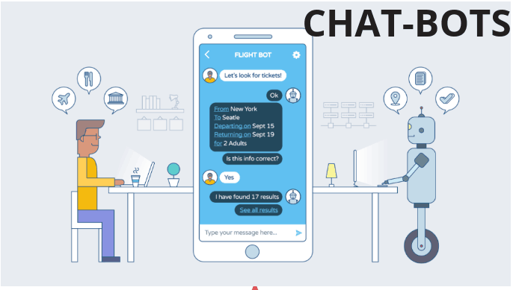
MODELLING
Teams cam add wireframes
3/21/2024 Annual Review

Slide 11
RESULTS 1.Importance of chatbots in enhancing customer experience 2.Encourage audience to explore chatbot implementation
DemoLink https://colab.research.google.com/drive/1auGkbN44spM6ldV2eRhZ9gL0t-GikcjW#scrollTo=kSKyP6VgXCpm
3/21/2024 Annual Review

